Slide 1




PHP Basics
Using Functions, Arrays, Associative Arrays, Strings, Objects and Classes
PHP Basics
SoftUni Team
Technical Trainers
Software University
http://softuni.bg

Slide 2



Table of Contents
Functions
Constants
Arrays
Associative Arrays
Strings
Dates
Classes and Objects
Constructors, Inheritance

Slide 3
Have a Question?
sli.do #9949

Slide 4
Functions in PHP
Functions in PHP are similar to JavaScript
Can take input parameters and return values
function calcRectangleArea($sideA, $sideB)
{
return $sideA * $sideB;
}
echo calcRectangleArea(2, 3) . "<br>\n"; // 6
echo calcRectangleArea(2.8, 2) . "<br>\n"; // 5.6
echo calcRectangleArea(3, 3) . "<br>\n"; // 9
Function definition. Put function's { and } on separate lines
Function call

Slide 5
Type-Hinting
Functions can define the types of parameters and return values
Types: int, float, string, bool, array, callable, SomeClass
function sum(int $a, int $b) : int
{
return $a + $b;
}
echo sum(2, 3) . "<br>\n"; // 5
echo sum(2.8, 2) . "<br>\n"; // 4
echo sum(3, 3) . "<br>\n"; // 6
Take int parameters, return int result
float values converted to int
4 = (int)2.8 + (int)2

Slide 6
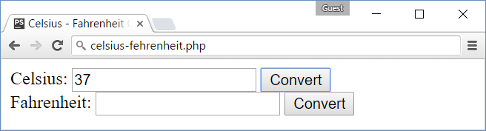
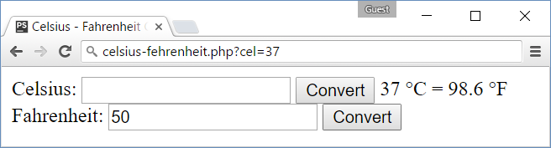
Problem: Celsius ↔ Fahrenheit
Write a PHP script to convert from Celsius to Fahrenheit
Print the result in format "132.8 °F = 56 °C" (use &deg; for °)

Slide 7
Solution: Celsius ↔ Fahrenheit
Define the degree conversion functions
function celsiusToFahrenheit(float $celsius) : float
{
return $celsius * 1.8 + 32;
}
function fahrenheitToCelsius(float $fahrenheit) : float
{
return ($fahrenheit - 32) / 1.8;
}

Slide 8
Solution: Celsius ↔ Fahrenheit (2)
Prepare the message to be shown after the Celsius form
$msgAfterCelsius = "";
if (isset($_GET['cel'])) {
$cel = floatval($_GET['cel']);
$fah = celsiusToFahrenheit($cel);
$msgAfterCelsius = "$cel &deg;C = $fah &deg;F";
}
$msgAfterFahrenheit = "";
if (isset($_GET['fah'])) {
$fah = floatval($_GET['fah']);
$cel = fahrenheitToCelsius($fah);
$msgAfterFahrenheit = "$fah &deg;F = $cel &deg;C";
}
Use &deg; to show the ° symbol

Slide 9
Solution: Celsius ↔ Fahrenheit (3)
<form>
Celsius: <input type="text" name="cel" />
<input type="submit" value="Convert">
<?= $msgAfterCelsius ?>
</form>
<form>
Fahrenheit: <input type="text" name="fah" />
<input type="submit" value="Convert">
<?= $msgAfterFahrenheit ?>
</form>
Check your solution here: https://judge.softuni.bg/Contests/Practice/Index/238#0

Slide 10
Constants and Include / Require
Constants in PHP hold configuration settings
define('name', value)
Including files in PHP:
require(…)
require_once(…)
include(…)
include_once(…)
settings.php
define('DB_HOST', 'localhost');
define('DB_PORT', 3306);
define('DB_USER', 'maria');
define('DB_PASS', '!p@$$w0rd');
main.php
require_once('settings.php');
echo DB_HOST . ':' . DB_PORT;

Slide 11
Arrays
Arrays in PHP hold indexed sequence of values
$towns = array('Sofia', 'Plovdiv', 'Varna');
echo $towns[0] . "<br>\n"; // Sofia
echo implode(", ", $towns); // Sofia, Plovdiv, Varna
$nums = [10, 20, 30, 40, 50];
for ($i = 0; $i < count($nums); $i++)
$nums[$i] = $nums[$i] * 2;
$nums[] = 1; // Add element 1 to $num
echo implode(", ", $nums); // 20, 40, 60, 80, 100, 1

Slide 12
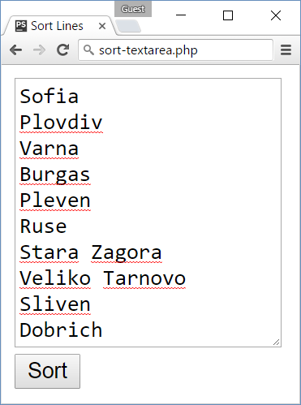
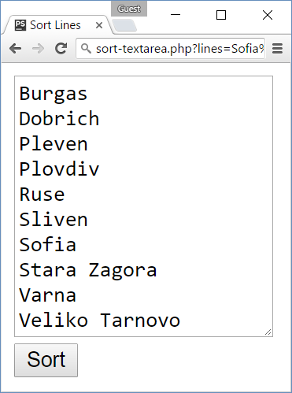
Problem: Sort Text Lines
Write a PHP script that sorts the text lines from a <textarea>

Slide 13
Solution: Sort Text Lines
Split by new line "\n". Warning: '\n' does not work!
<?php $sortedLines = "";
if (isset($_GET['lines'])) {
$lines = explode("\n", $_GET['lines']);
$lines = array_map('trim', $lines);
sort($lines, SORT_STRING);
$sortedLines = implode("\n", $lines);
} ?>
<form>
<textarea rows="10" name="lines"><?= $sortedLines
?></textarea> <br>
<input type="submit" value="Sort">
</form>
Remove \r and spaces when exist
Sort as string values
Warning: '\n' will not work!
Never put space between <textarea> and </textarea>
Check your solution here: https://judge.softuni.bg/Contests/Practice/Index/238#1

Slide 14
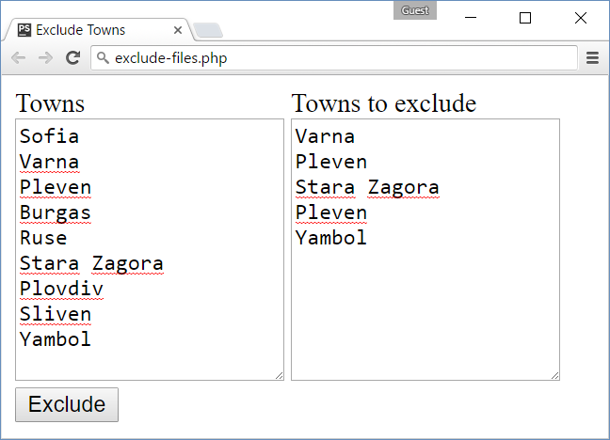
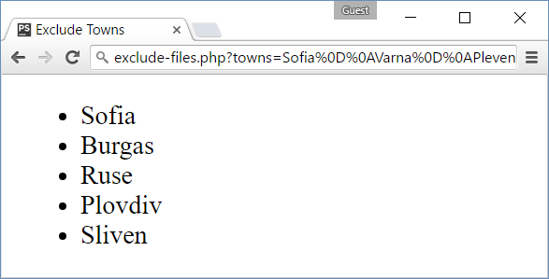
Problem: Exclude Towns
Write a PHP script to take two lists of strings (as <textarea>) and exclude from the first list all strings from the second
Print the output as ordered list of items

Slide 15
Solution: Exclude Towns
<form>
<div style="display:inline-block">
<div>Towns</div>
<textarea rows="10" name="towns"></textarea>
</div>
<div style="display:inline-block">
<div>Towns to exclude</div>
<textarea rows="10" name="townsToExclude"></textarea>
</div>
<div><input type="submit" value="Exclude"></div>
</form>

Slide 16
Solution: Exclude Towns (2)
function excludeFromArray(array $arr, array $excludeArr) : array
{
$result = [];
foreach ($arr as $item)
if (!in_array($item, $excludeArr)) $result[] = $item;
return $result;
}
function printAsList(array $arr)
{
echo "<ul>\n";
foreach($arr as $item) echo "<li>$item</li>\n";
echo "</ul>\n";
}

Slide 17
Solution: Exclude Towns (3)
if (isset($_GET['towns']) && isset($_GET['townsToExclude'])) {
$towns = array_map('trim', explode("\n", $_GET['towns']));
$townsToExclude =
array_map('trim', explode("\n", $_GET['townsToExclude']));
$remainingTowns = excludeFromArray($towns, $townsToExclude);
printAsList($remainingTowns);
} else {
// TODO: print the HTML form
}
Check your solution here: https://judge.softuni.bg/Contests/Practice/Index/238#2

Slide 18
Associative Arrays
Associative arrays in PHP hold {key → value} pairs
$ages = ["Nakov" => 25, "Maria" => 22, "George" => 12];
echo $ages['Nakov'] . "<br>\n"; // 25
$ages['Kiro'] = 15; // Add new key-value pair
$ages['Nakov'] = 26; // Change existing value for given key
unset($ages['George']); // Delete existing key
$ages['Maria'] = 'no age'; // Mixing types is allowed
foreach ($ages as $name => $age) {
echo "Name: $name, age: $age<br>\n";
}

Slide 19
Problem: Sums by Town
You are given a sequence of strings holding town:income
Write a PHP script to sum and print the incomes for each town
Sofia:200
Varna:120
Pleven:60
Varna:70
Towns can appear multiple times
Pleven -> 60
Sofia -> 200
Varna -> 190
Order the towns by name
Check your solution here: https://judge.softuni.bg/Contests/Practice/Index/238#3

Slide 20
Solution: Sums by Town
function calcSumsByTown(array $townsIncomes) : array
{
$sums = []; // Empty associative array to hold {town -> sum}
foreach ($townsIncomes as $townIncome) {
$tokens = explode(':', $townIncome);
$town = $tokens[0]; $income = $tokens[1];
if (isset($sums[$town]))
$sums[$town] += $income;
else
$sums[$town] = $income;
}
ksort($sums);
return $sums;
}

Slide 21
Solution: Sums by Town (2)
<?php
if (isset($_GET['towns-incomes'])) {
$townsIncomes = array_map('trim',
explode("\n", $_GET['towns-incomes']));
$sumsByTown = calcSumsByTown($townsIncomes);
foreach ($sumsByTown as $town => $sum)
echo $town . " -> " . $sum . "<br>\n";
} ?>
<form>
<textarea rows="10" name="towns-incomes"></textarea><br>
<input type="submit" value="Calculate">
</form>
Check your solution here: https://judge.softuni.bg/Contests/Practice/Index/238#3

Slide 22
Strings in PHP
Strings in PHP hold a sequence of non-Unicode characters (bytes)
$lang = 'PHP';
$str = "I love $lang<br>\n";
echo $str; // I love PHP<br>
$broken = 'I love $lang<br>\n';
echo $broken; // I love $lang<br>\n
$tokens = explode(',', 'PHP,,,, SQL, HTML, Java');
$tokens = array_filter(array_map('trim', $tokens));
echo strtolower(implode(' - ', $tokens));
// php - sql - html - java

Slide 23
Problem: Extract Capital-Case Words
Write a PHP script to extract from array of strings all capital-case words. All non-letter chars are considered separators.
We start by HTML, CSS, JavaScript, JSON and REST.
Later we touch some PHP, MySQL and SQL.
Later we play with C#, EF, SQL Server and ASP.NET MVC.
Finally, we touch some Java, Hibernate and Spring.MVC.
HTML, CSS, JSON, REST, PHP, SQL, C, EF, SQL, ASP, NET, MVC, MVC
Check your solution here: https://judge.softuni.bg/Contests/Practice/Index/238#4

Slide 24
Solution: Extract Capital-Case Words
Extract all non-empty sequences of letters \w+ in new array $words
if (isset($_GET['text'])) {
$text = $_GET['text'];
preg_match_all('/\w+/', $text, $words);
$words = $words[0];
$upperWords = array_filter($words, function($word){
return strtoupper($word) == $word;
});
echo implode(', ', $upperWords);
}
// TODO: make HTML form holding <textarea name="text">
$words holds array of arrays of strings
Check your solution here: https://judge.softuni.bg/Contests/Practice/Index/238#4

Slide 25
Working with Dates
// Get the current date and time
date_default_timezone_set('Europe/Sofia');
$date = new DateTime('now');
echo $date->format("d-M-Y H:i");
// Calculate the date of tomorrow
$tomorrow = $date->modify('+1 day');
// Parse date (from string to date)
$str = "31-12-2016 23:59";
$d = DateTime::createFromFormat('d-m-Y H:i', $str);
echo $d->format("d-m-Y H:i");
Set the time zone. Otherwise it will be taken from php.ini or UTC will be used.

Slide 26
Classes and Objects
class Student
{
protected $name;
protected $age;
function __construct($name, $age)
{
$this->name = $name;
$this->age = $age;
}
public function __toString()
{
return "Name: $this->name; Age: $this->age";
}

Slide 27
Classes and Objects (2)
function getName()
{ return $this->name; }
function setName($name)
{ return $this->name = $name; }
function getAge()
{ return $this->age; }
function setAge($age)
{ return $this->age = $age; }
}

Slide 28
Classes and Objects (3)
class SpecialStudent extends Student
{
private $email;
function __construct($name, $age, $email)
{
parent::__construct($name, $age);
$this->email = $age;
}
public function __toString()
{
return parent::__toString() . " Email: $this->email";
}
}

Slide 29
Classes and Objects (4)
$pesho = new Student("Pesho", 20);
$gosho = new Student("Gosho", 21);
$maria = new SpecialStudent("Maria", 21, "m@abv.bg");
echo $pesho; // Name: Pesho; Age: 20
echo "<br>\n";
echo $gosho->getName(); // Gosho
echo "<br>\n";
echo $maria; // Name: Maria; Age: 21 Email: 21

Slide 30

Summary
Functions are like JS, but can specify types
Constants: define('constant', value)
Arrays work like in C# / JavaScript
Associative arrays are like dictionaries in C#
Strings are non-Unicode sequences of chars
PHP provides rich set of date / time functions
PHP supports classical OOP: classes, objects, inheritance, constructors, interfaces, …

Slide 31








PHP Basics
https://softuni.bg/courses/software-technologies

Slide 32
License
This course (slides, examples, demos, videos, homework, etc.) is licensed under the "Creative Commons Attribution-NonCommercial-ShareAlike 4.0 International" license

Slide 33






Free Trainings @ Software University
Software University Foundation – softuni.org
Software University – High-Quality Education, Profession and Job for Software Developers
softuni.bg
Software University @ Facebook
facebook.com/SoftwareUniversity
Software University @ YouTube
youtube.com/SoftwareUniversity
Software University Forums – forum.softuni.bg

